Slide 1

Armed Forces College of Medicine
AFCM

Slide 2
Jaundice - 1

Slide 3
Intended learning outcomes (ILOs)
By the end of this lecture the student will be able to:
Define jaundice and its types
Recognize basic concepts of bilirubin metabolism
List the causes of jaundice
Differentiate between causes of jaundice
Define important clues in history
Ask and interpret proper lab tests
Asks for proper imaging

Slide 4




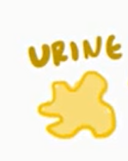

Introduction
The term jaundice refers to yellow pigmentation of
It is caused by elevated serum bilirubin levels hyperbilirubinemia).
Normal serum bilirubin levels range from 0.5 to 1.0 mg/dL, and plasma bilirubin concentrations typically must exceed 2.5 mg/dL before jaundice becomes evident clinically.

Slide 5
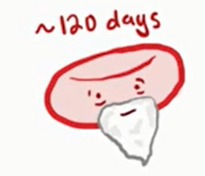
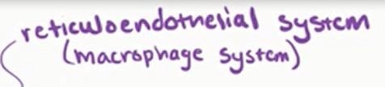

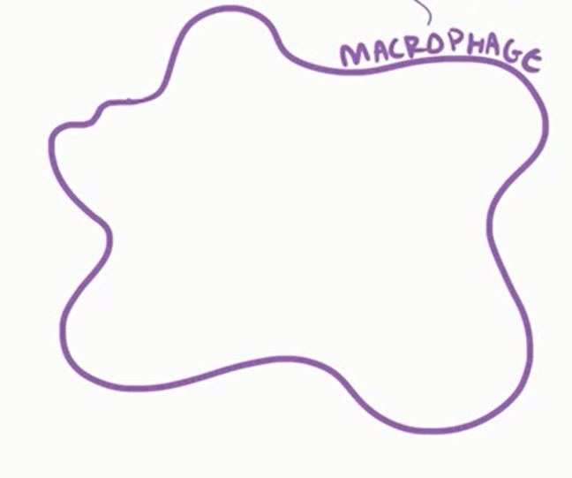










BILIRUBIN METABOLISM
HB

Slide 6
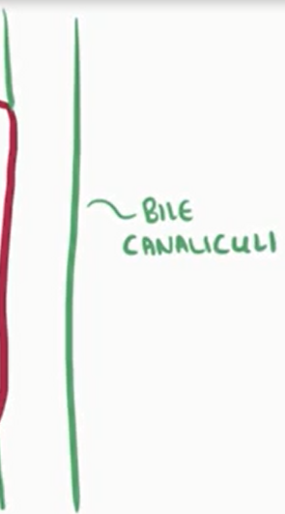

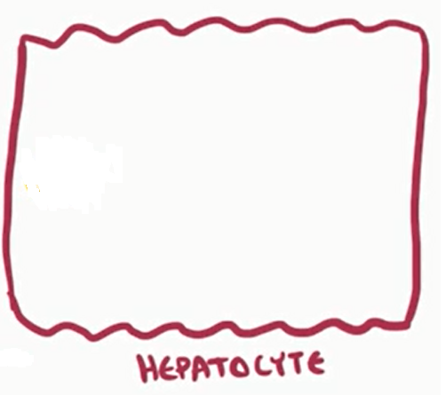

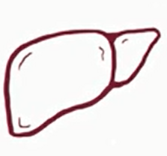






BILIRUBIN METABOLISM
Bilirubin transporter
Multidrug resistant associated protein (MRP2)
Bile ducts
Gall bladder

Slide 7
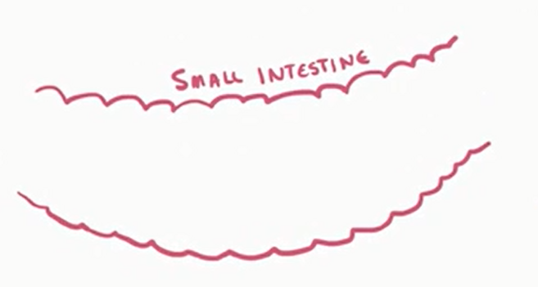

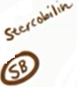
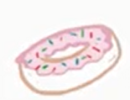

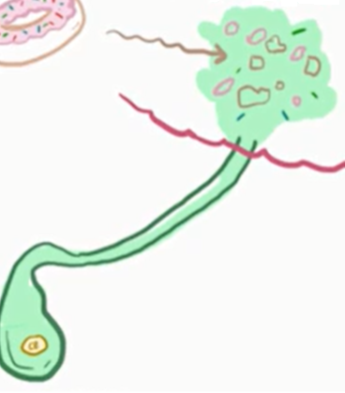



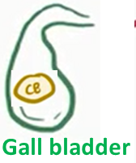




BILIRUBIN METABOLISM

Slide 8

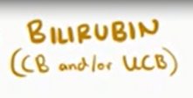
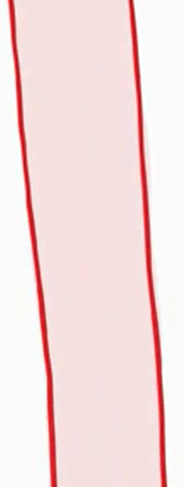


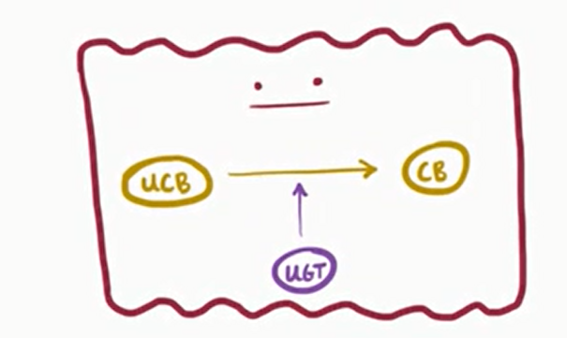




Pathophysiology and causes

Slide 9
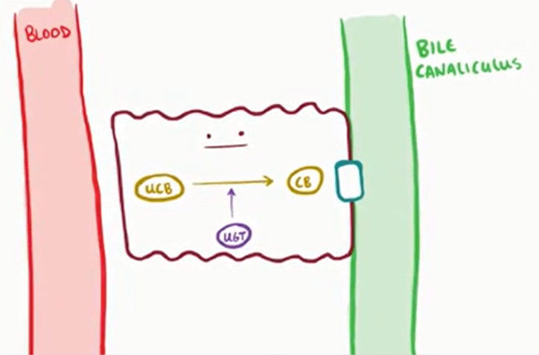
Classification causes of jaundice
POSThepatic causes
PREhepatic causes
Predominant Conjugated (Direct) Hyperbilirubinemia
Predominant Unconjugated (Indirect) Hyperbilirubinemia
Hepatic causes
Unconjugated Hyperbilirubinemia
Conjugated (Direct) Hyperbilirubinemia
Biphasic (combined) Hyperbilirubinemia

Slide 10
Prehepatic Causes
Predominantly Unconjugated Hyperbilirubinemia:
Hemolysis (e.g., sickle cell disease, autoimmune hemolytic anemia, mechanical cardiac valve with accelerated red cell destruction).
Microbe-induced hemolysis (malaria, leptospirosis).
Ineffective erythropoiesis (e.g., megaloblastic anemias)
Hematoma resolution.
Drugs induced hemolysis: Ribavirin, Cephalosporins, Penicillin and its derivatives, Nitrofurantoin, Levofloxacin, Levodopa, Quinidine,

Slide 11
Hepatic causes
(1)Unconjugated
(2) Conjugated
(3) Combined
↓Hepatic uptake
↓Conjugation
Intrahepatic cholestasis
Drugs: rifampin, probenecid, sulfonamides.
Herbal medicines الاعشاب
Diminished uptake in newborn or premature infants

Slide 12
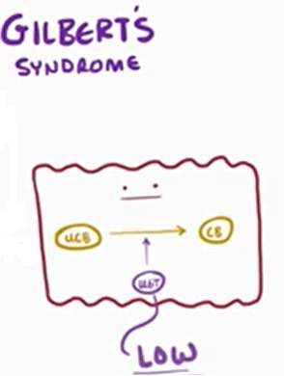
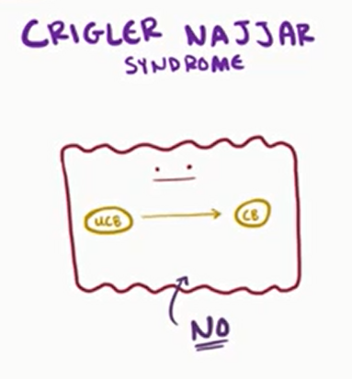
Hepatic causes
(1)Unconjugated
(2) Conjugated
(3) Combined
↓Hepatic uptake
↓Conjugation
Intrahepatic cholestasis
Due to limited uridine glucuronyl transferase activity
Inherited conditions
- Gilbert’s syndrome
- Crigler-Najjar syndrome types I and II
Physiological jaundice of neonates
Breast-milk jaundice
Drug-induced inhibition (e.g. ketoconazole, chloramphenicol, HIV Protease inhibitors – Indinavir & Atazanavir)
Notes:
Neonatal physiologic jaundice results from increase Bilirubin production from breakdown of fetal erythrocytes Hepatic excretory capacity is low both because of low concentrations of the binding protein ligandin in the hepatocytes and because of low activity of glucuronyl transferase

Slide 13
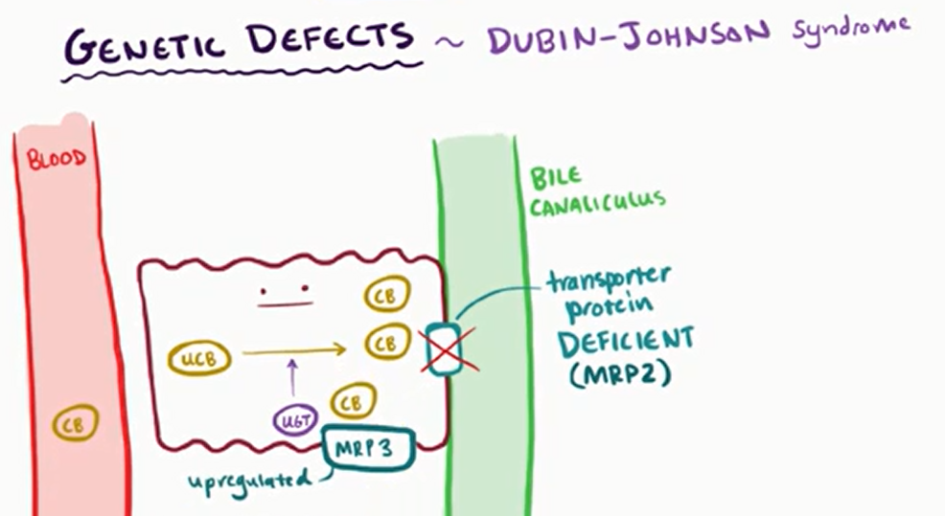
Hepatic causes
(1)Unconjugated
(2) Conjugated
(3) Combined
↓Hepatic uptake
↓Conjugation
Intrahepatic cholestasis
Familial cholestatic disorders (Dubin-Johnson syndrome, Rotor’s syndrome, benign recurrent cholestasis, cholestasis of pregnancy)
Inflammation of intrahepatic bile ductules and/or portal tracts: Primary Biliary cholangitis, liver allograft rejection, graft-versus-host disease, drugs (e.g., chlorpromazine, erythromycin, anabolic and contraceptive steroids)
Diffuse infiltrative disorders (Lymphoma, Sarcoidosis, infiltrative malignancies & metastases)
Uncommon presentations of viral or alcoholic hepatitis, Sepsis

Slide 14
Hepatic causes
(1)Unconjugated
(2) Conjugated
(3) Combined
↓Hepatic uptake
↓Conjugation
Intrahepatic cholestasis
Hepatitis: Viral: HAV, HBV, HCV, HEV , EBV, CMV ALD, NAFLD Autoimmune diseases Wilson's disease Hemochromatosis α1-antitrypsin deficiency Ischemia | Liver cirrhosis Drug: (acetaminophen, INH, α-methyldopa, halothane) Congestive HF Sepsis

Slide 15
Hepatic causes
(1)Unconjugated
(2) Conjugated
(3) Combined
↓Hepatic uptake
↓Conjugation
Familial cholestatic disorders (Dubin-Johnson syndrome, Rotor’s syndrome, benign recurrent cholestasis, cholestasis of pregnancy)
PBC, PSC
liver allograft rejection, graft-versus-host disease
Drugs: anabolic erythromycin, chlorpromazine, contraceptive steroid
Hepatic Infiltration by lymphoma, sarcoidosis, extensive metastases
Hepatitis:
Viral: HAV, HBV, HCV, HEV , EBV, CMV
ALD, NAFLD
Autoimmune diseases
Wilson's disease
Hemochromatosis
α1-antitrypsin deficiency
Liver cirrhosis
Drug: (acetaminophen, INH, α-methyldopa, halothane)
Congestive HF
Sepsis
Drugs:
rifampin, Probenecid, sulfonamides
Herbal medicines
Newborn or premature infants
Gilbert’s syndrome
Crigler-Najjar syndrome types I and II
Physiological neonatal jaundice
Breast-milk jaundice
Drug-induced inhibition (e.g., ketoconazole, chloramphenicol, HIV Protease inhibitors – Indinavir & Atazanavir)

Slide 16
Posthepatic causes = Extrahepatic cholestasis
Lumen
Wall (Stricture)
Extrinsic Compression
Gallstones
Parasites: Ascaris – Fasciola hepatica
Inflammation, infection:
- Primary sclerosing cholangitis
AIDS cholangiopathy
Hepatic arterial chemotherapy
- Postsurgical strictures
Neoplasms:
Cholangiocarcinoma
Congenital disorders biliary atresia, cystic fibrosis
Neoplasms
Pancreatic carcinoma
Malignant involvement of the porta hepatis: Metastatic LN, Hepatoma
Chronic Pancreatitis with or without pseudocyst formation (fibrosis)
Vascular enlargement
- Aneurysm
- Cavernous transformation of portal vein

Slide 17
Lab Diagnosis of Jaundice – D.D
Features | Prehepatic (Heamolytic) | Intrahepatic (Hepatocellular) | Posthepatic (Obstructive)
Unconjugated | ↑ | ↑ | Normal
Conjugated | Normal | ↑ | ↑
AST or ALT | Normal | ↑ ↑ | Normal
Alkaline phos. and GGT | Normal | Normal | ↑ ↑
Urine bilirubin | Absent | Present | Increased
Urobilinogen | Increased | Present | Absent

Slide 18
Clinical Aspects of Jaundice
Clinically detectable if SB is >2.0 mg%
What is special about the sclera ? – Rich Elastin
Skin discoloration – Yellowish, Carotinemia (normal sclera)
Greenish hue of skin and sclera - due Biliverdin – indicates long standing jaundice
Generalized Pruritus (Obstructive Jaundice).
With edema and dark skin – Jaundice is masked
Mucosa – hard palate (in dark skinned)
Darkening of the urine – Differential Diagnosis

Slide 19
Differential Diagnosis of Colored Urine
Bilirubin in urine due to Jaundice (CB).
Concentrated urine in dehydration.
Sulfasalazine use – for Ulcerative colitis
Rifampicin, Pyridium and Thiamine use
Red urine – Porphyria.
Hemoglobin & Myoglobinuria, Hematuria.
Others .

Slide 20
Clinical History – Imp clues
Duration of jaundice: Acute / Chronic.
Abdominal pain vs painless jaundice.
Fever: Viral / bacteria /sepsis.
Appetite – Hepatocellular / Malignancy
Weight loss – Malignancy
Colour of stools –chalky white –obstructive
Family history – Hemolytic – Inherited dis.
History of blood transfusion
Alcohol abuse, Medications – INH, Erythromycin

Slide 21
Algorithmic approach for Jaundice
How to clinically evaluate the patient ?
What tests will help us in D.D ?
What imaging modalities will be useful ?

Slide 22
Patient with Jaundice
- History: Focus on recent drug history or anaesthesia exposure
- Physical examination
Bilirubin (Total & direct), ALT, AST, ALP, GGT, PT, Albumin
Isolated Bilirubin elevation
1
Elevated Bilirubin and other liver enzymes
2
Indirect Hyperbilirubinemia
Direct Hyperbilirubinemia
ALT & AST elevated out of proportion to ALP &GGT
ALP &GGT elevated out of proportion to ALT & AST
- Haemolysis
- Ineffective erythropoiesis (Vit. B12 deficiency)
Inherited disorders
Dubin-Johnson syn.
Rotor Syndrome
Hepatocellular pattern
2
Cholestatic pattern
1- Virological markers
HAV IgM, HBsAg, HBcIgM, HCV AB /PCR
2-ANA, ASMA, SPEP
3- Ceruloplasmin (<40)
4- Acetaminophen level
Abdominal U/S
Drugs
Rifampicin
Probenecid
3
Dilated ducts → Extrahepatic cholestasis
No dilated ducts → Intrahepatic cholestasis
Inherited disorders
Gilbert’s syndrome
Crigler-Najjar syn.
If negative results
1- EBV - CMV
2-HEV IgM , HDV Ab (in HBV patients)
CT/MRCP/ERCP
- AMA
Virological markers
Drug history
If negative results
If negative results
If AMA +ve
Liver biopsy
MRCP/Liver biopsy
Liver biopsy

Slide 23
Patient with Jaundice
- History: Focus on recent drug history or anaesthesia exposure
- Physical examination
Bilirubin (Total & direct), ALT, AST, ALP, GGT, PT, Albumin
Isolated Bilirubin elevation
1
Elevated Bilirubin and other liver enzymes
2
Indirect Hyperbilirubinemia
Direct Hyperbilirubinemia
ALT & AST elevated out of proportion to ALP &GGT
ALP &GGT elevated out of proportion to ALT & AST
- Haemolysis
- Ineffective erythropoiesis (Vit. B12 deficiency)
Inherited disorders
Dubin-Johnson syn.
Rotor Syndrome
Hepatocellular pattern
2
Cholestatic pattern
1- Virological markers
HAV IgM, HBsAg, HBcIgM, HCV AB /PCR
2-ANA, ASMA, SPEP
3- Ceruloplasmin (<40)
4- Acetaminophen level
Abdominal U/S
Drugs
Rifampicin
Probenecid
3
Dilated ducts → Extrahepatic cholestasis
No dilated ducts → Intrahepatic cholestasis
Inherited disorders
Gilbert’s syndrome
Crigler-Najjar syn.
If negative results
1- EBV - CMV
2-HEV IgM , HDV Ab (in HBV patients)
CT/MRCP/ERCP
- AMA
Virological markers
Drug history
If negative results
If negative results
If AMA +ve
Liver biopsy
MRCP/Liver biopsy
Liver biopsy

Slide 24
What imaging we need?
Ultrasonography – 98% Sp, 90% Sen.
For GB stones USG better than CT
For duct stones –only 40% seen in USG
MRCP – Most useful for duct stones
ERCP – Distal biliary obstruction Dx. Rx.
PTC – Extrahepatic obstr. – drainage

Slide 25
References
Cecil essential PDF
http://gsia.tums.ac.ir/Images/Download/9762/Cecil_Essential_Of_Medicine.pdf
Jaundice
https://www.youtube.com/watch?v=gIACp5js4MU
Bilirubin metabolism
https://www.youtube.com/watch?v=-bZmC07L394
http://www.namrata.co/case-studies-jaundice/

Slide 26
Thank You

